Slide 1
Monstrosity Inc. Technical Solution
Ronny Soto, Ny Tran, Domonic Neal

Slide 2
Project Synopsis
Monstrosity Inc.
5 Satellite offices & 1 Corporate Location
Wi-Fi Connectivity (Customers and Employees)
Security
Web Traffic monitoring
Email monitoring
Employee Access
Basic Access (printer, scanners, etc)
Access Elevation (payroll, employment, etc)

Slide 3
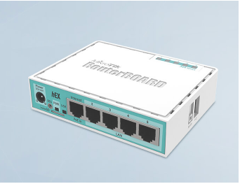
MikroTik aC Lite
Cheap, but highly functional router
MPLS Capable
Compact and reliable
Easy to implement

Slide 4
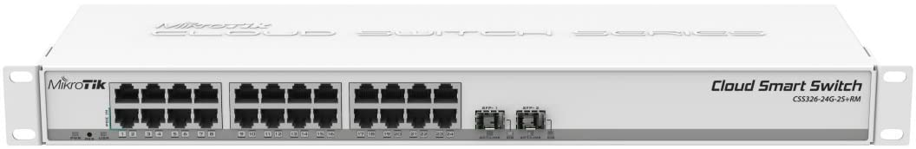
MikroTik Cloud Smart Switch
Full management of ports
Switch configurations
Bandwidth limitations
Enable communication between devices on the network
Mange flow of data across the network
Easy to manage via RouterOS

Slide 5
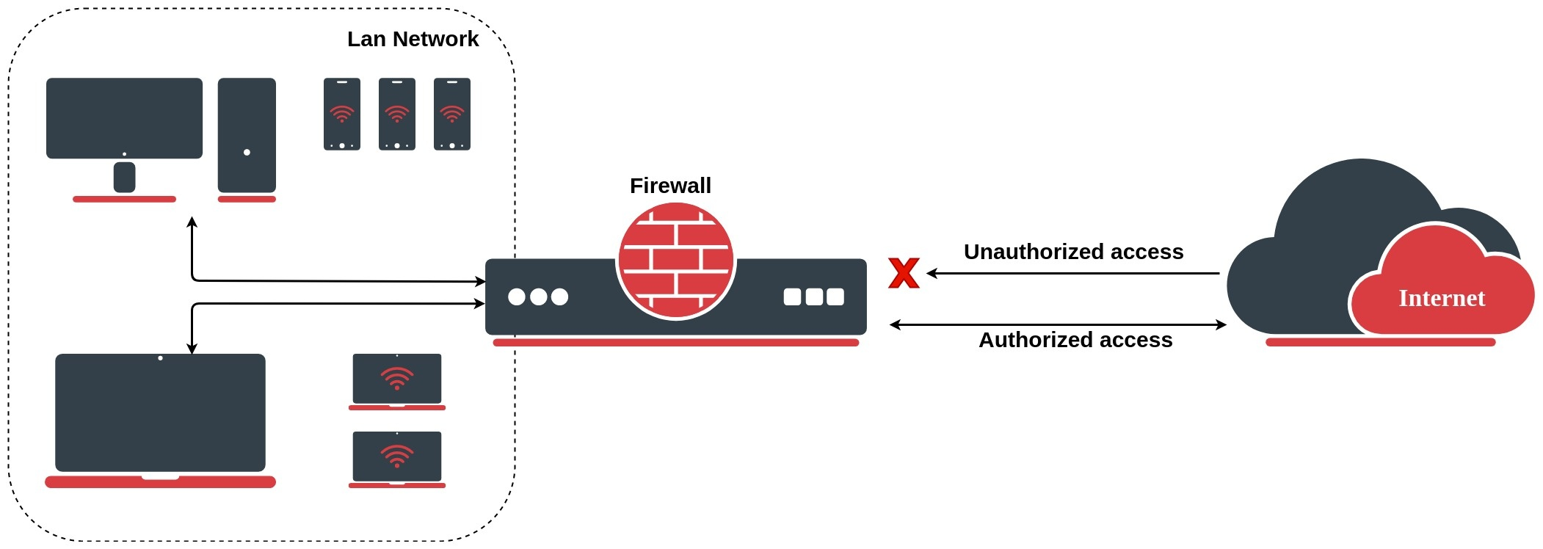
Security (Web and E-mail monitoring)
RouterOS:
Connection tracking
Filters
NAT
Email monitoring
Winbox:
Monitors traffic of every interface, queue or firewall rule in real-time
Quickset:
HomeAP - configure an access point at home

Slide 6
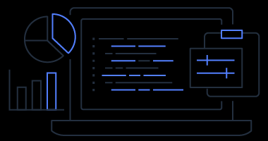
AWS Microsoft Managed AD - User Access
Provides users and groups with access to resources in either domain, using single sign-on (SSO)
Enable multi-factor authentication
Shares a single directory for cloud workloads

Slide 7
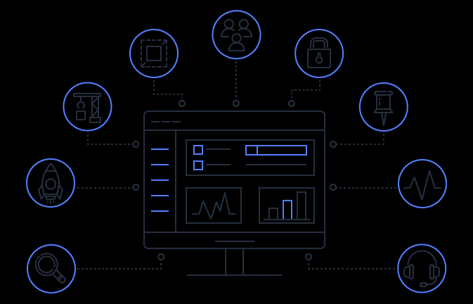
Amazon Web Services - Directory Services
Easy to manage on-prem and cloud workloads
Manage application access and devices using AWS Cloud
High Availability and trusted support

Slide 8
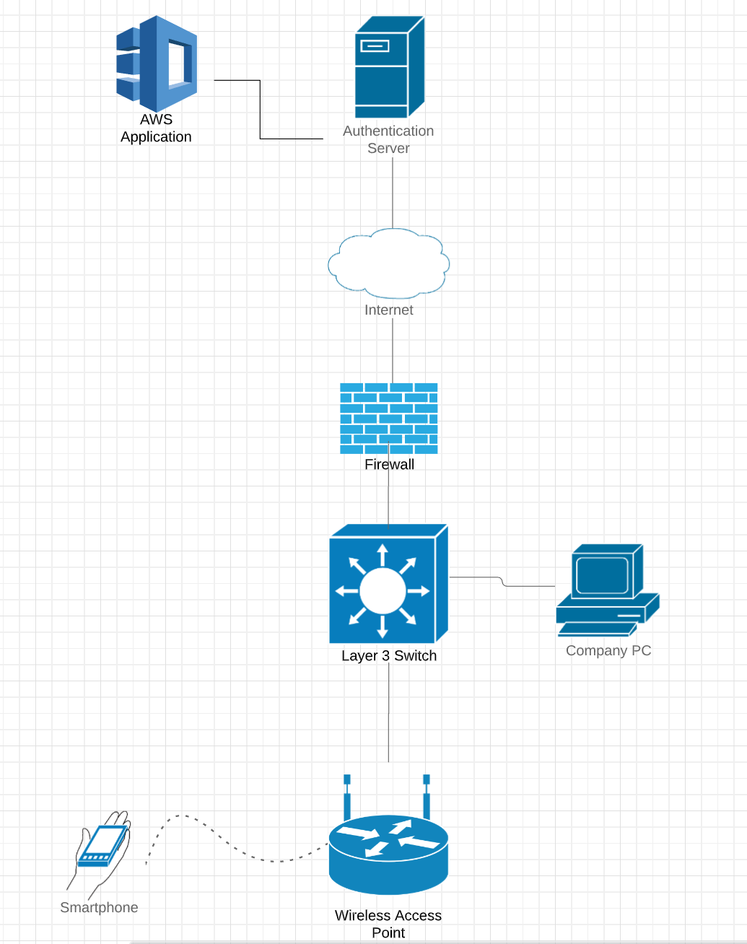

Slide 9
Database: Amazon Aurora
MySQL and PostgreSQL relational database built for the cloud
Managed by Amazon Relational Database Services (RDS)
No Redundancy
High Performance and Scalability

Slide 10
Establishing connection between locations
Multiprotocol Label Switching (MPLS)
Full Mesh topology
Each router board will be connected via Public IP Address
Everyone at each separate location will be part of the network
Each building will have access to one another.

Slide 11
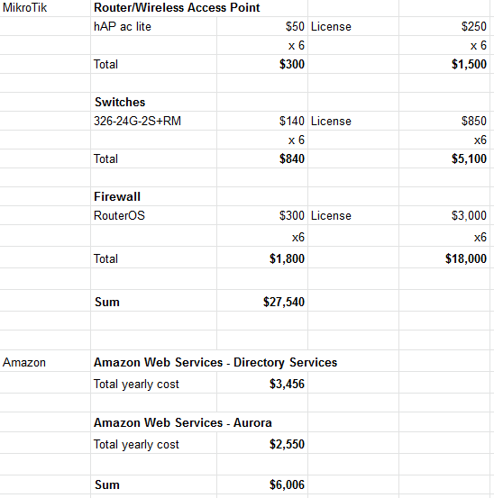
Network Costs

